Slide 1
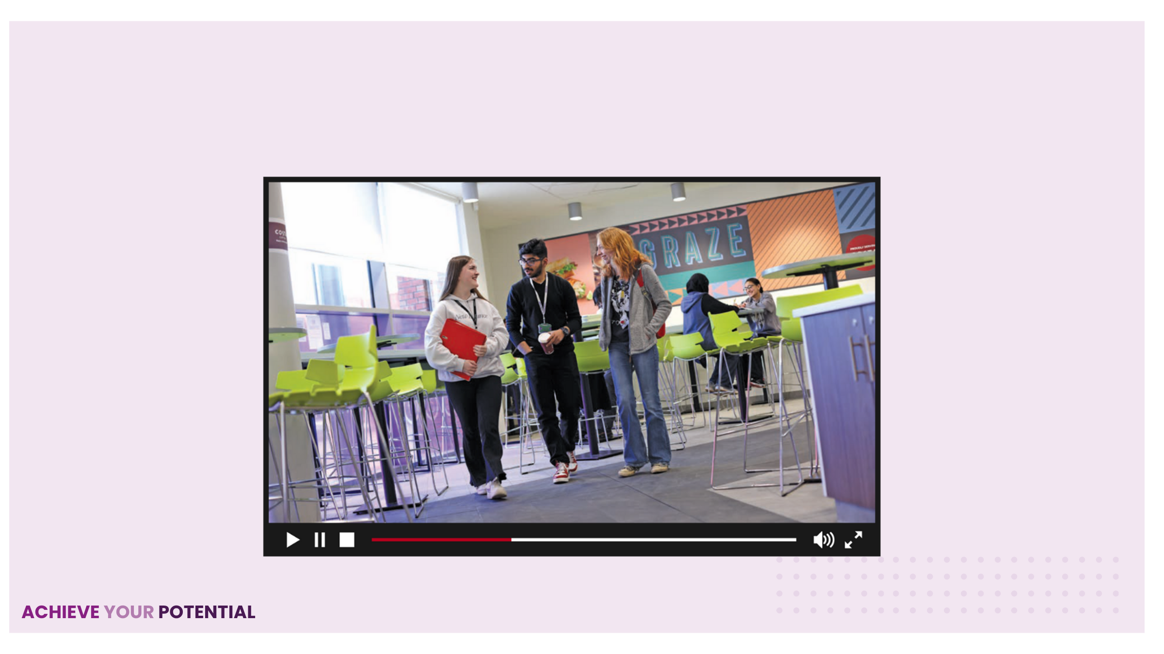
RESULTS DAY PROMO FILM
https://youtu.be/VrB_VLre1FQ

Slide 2


Slide 3
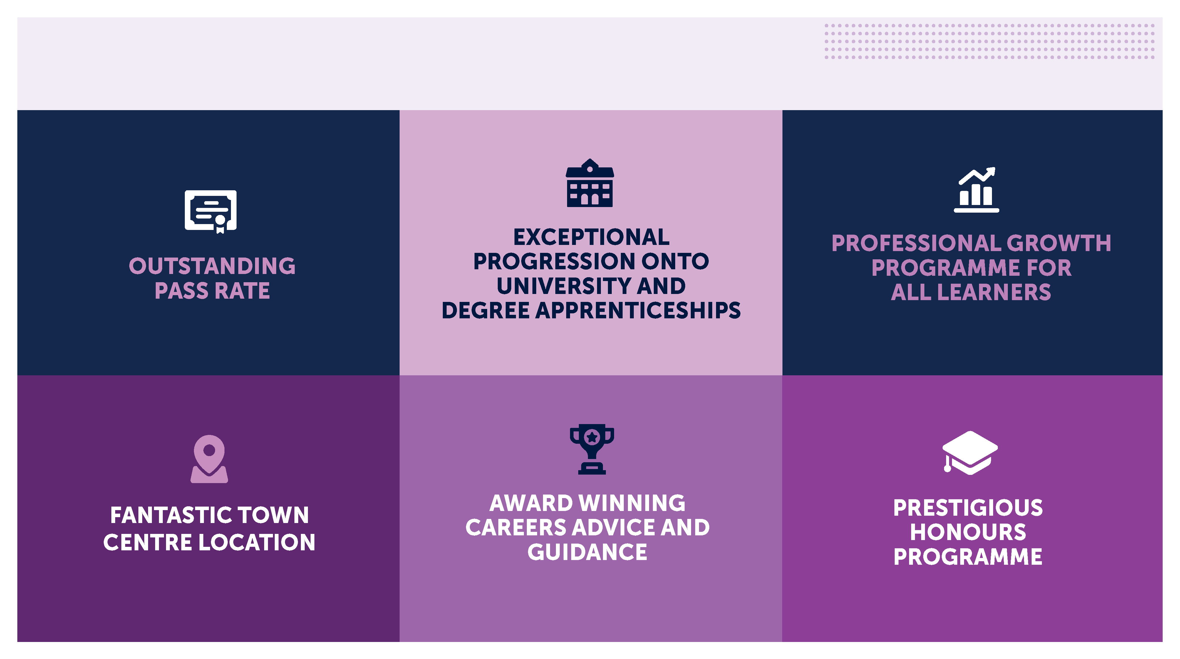
WHY CHOOSE B6?

Slide 4
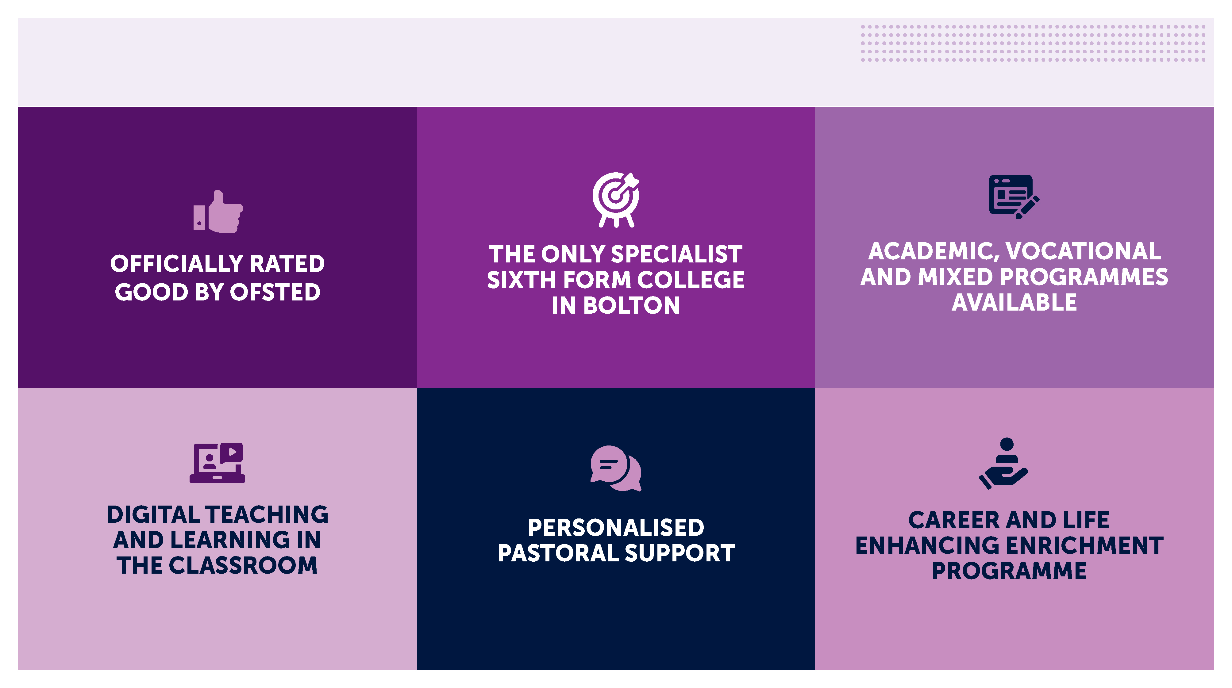
WHY CHOOSE B6?

Slide 5
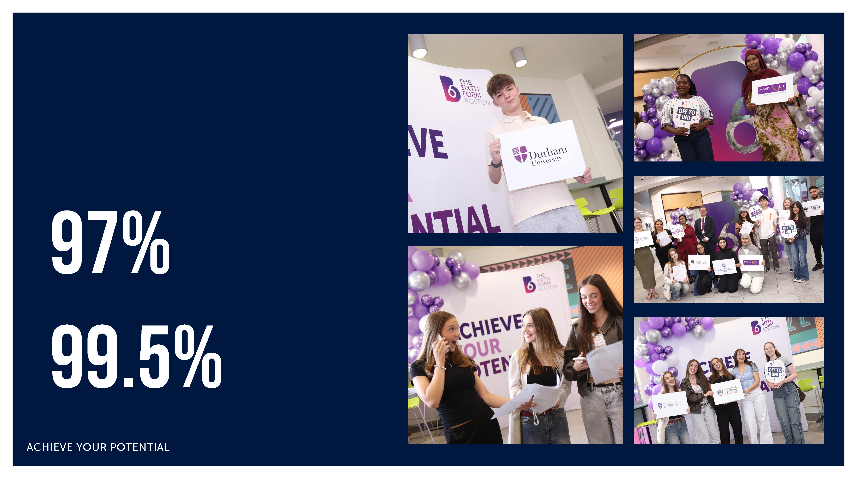
SUCCESS
CELEBRATING ANOTHER YEAR OF OUTSTANDING RESULTS
A LEVEL PASS RATE
VOCATIONAL STUDENTS ACHIEVING HIGHER- GRADE PASSES

Slide 6

YOUR STUDY
PROGRAMME

Slide 7
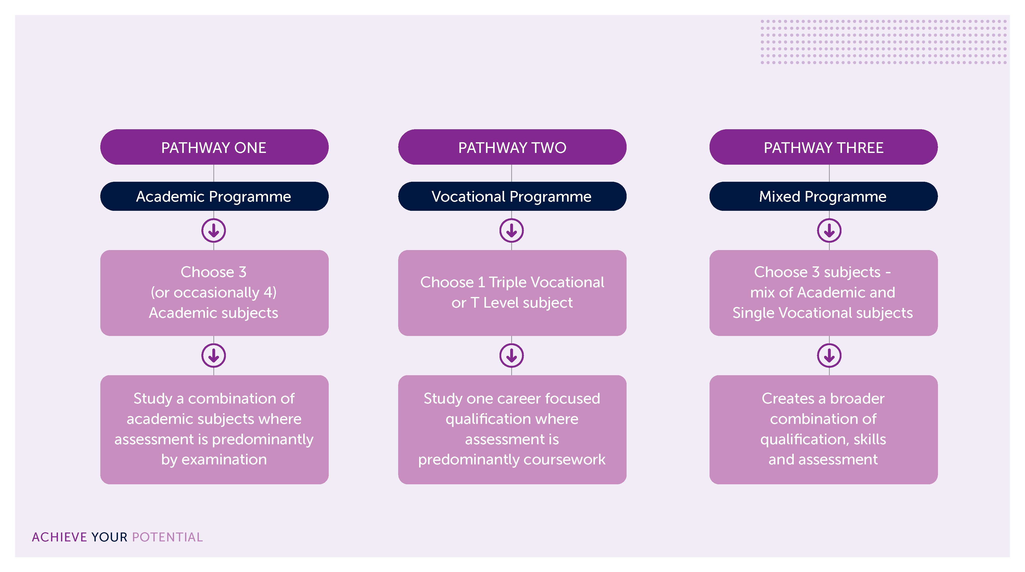
CHOOSING YOUR STUDY PROGRAMME

Slide 8

ACADEMIC SUBJECT LIST
Accounting
Art (Fine Art)
Art, Craft & Design
Biology
Business
Chemistry
Computer Science
Computing (AAQ)
Digital Games Production (AAQ)
Drama & Theatre Studies
Early Childhood Development (AAQ)
Economics
English Language
English Language & Literature
English Literature
Film Studies
French
Geography
Graphic Design
Health & Social Care (AAQ)
History
Information Technology (AAQ)
Law
Mathematics
Mathematics - Further
Mathematics - Core (AS Level equivalent)
Media Studies
Mental Health & Well-being (AAQ)
Photography
Physical Education
Physics
Politics
Psychology
Religion, Ethics & Philosophy
Science (AAQ)
Science (Medical) (AAQ)
Sociology
Spanish

Slide 9
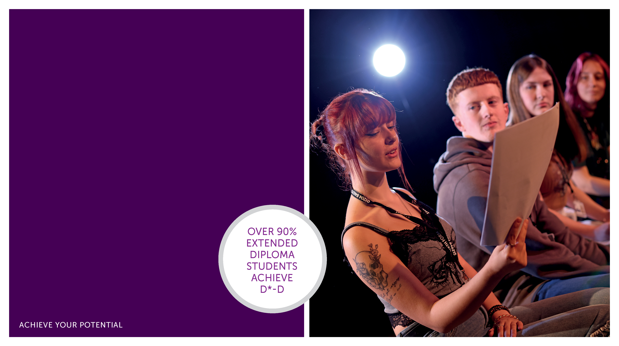
VOCATIONAL SUBJECT LIST
T Levels
Education and Early Years
Double Vocational
Music Technology
Performing Arts
Single Vocational
Business
Criminology
Law (Applied)
Music
Music Technology
Performing Arts
Public Services (Uniformed)
Sport Science
Triple Vocational
Art, Design, and Communication (UAL)
Business
Public Services (Uniformed)
Sport Science

Slide 10

ENTRY REQUIREMENS
A Levels and AAQs
A minimum of two GCSEs at grade 5 and three at grade 4, including English Language and Mathematics.
Individual subjects may have specific and higher entry requirements.
Vocational Subjects:
A minimum of five GCSEs at grade 9-4, including a grade 4 in GCSE English Language.
Individual subjects have specific and higher entry requirements.

Slide 11
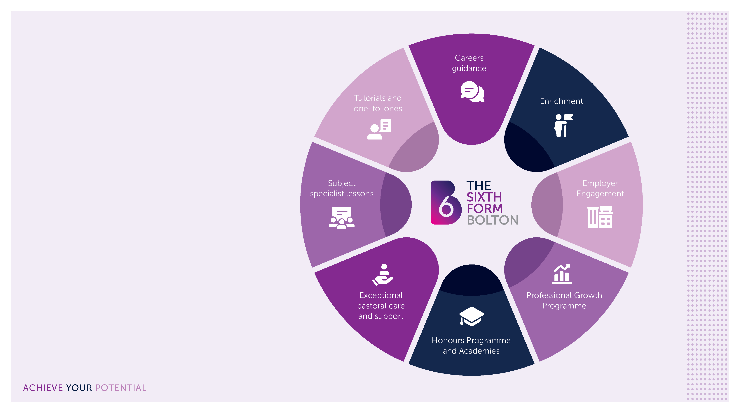
YOUR STUDY
PROGRAMME
At B6 we believe in developing the whole person not just your academic skills.
Your bespoke study programme at B6 includes:

Slide 12
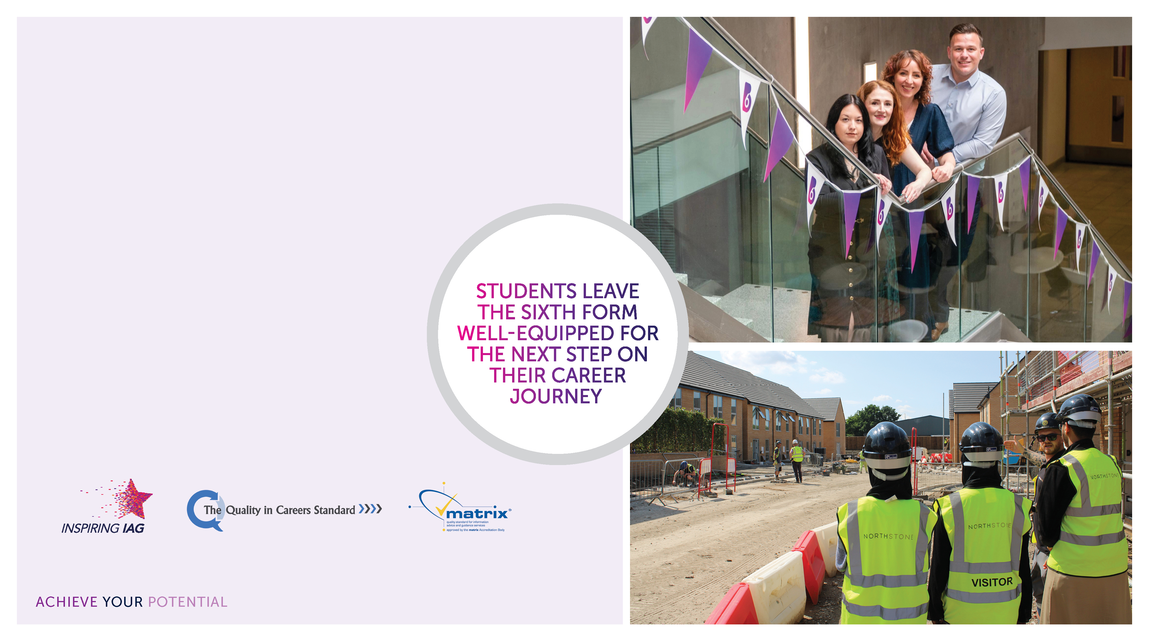
CAREERS AT B6
1:1 advice and guidance
Work experience
Careers events and employer engagement
Professional Growth Programme
Apprenticeship academy
AWARD WINNING
CAREERS TEAM

Slide 13

ENRICHMENT
POPULAR ENRICHMENT CHOICES INCLUDE:
Aspiring to STEM Group
Boys & Girls Football
Chess Club
College Band
Debating Society
Driving Theory
Futures Academy
Intelligence & Security Group
Japanese Club
Keep Bolton Tidy
Law Society
Learner Voice
Level 2 Gym Instructor Course
Mental Health First Aiders
Performing Arts Academy
Podcasting
Pokémon Club
Policing Academy
Primary School Reading Scheme
Scrubbed Up
Sign Language
Sport Performance Pathway
Student Leadership Programmes
The Green Club
Voluntary Service Award

Slide 14

SPORTS
ACADEMIES
Our Sports Academies offer you a fantastic opportunity to develop and excel in elite and competitive sports.
B6 OFFERS THE FOLLOWING SPORTS ACADEMIES:
Boys and Girls Football
Boys and Girls Cricket
Sport Performance Pathway - a bespoke training and development programme for young athletes who compete at a high level in any sport.

Slide 15
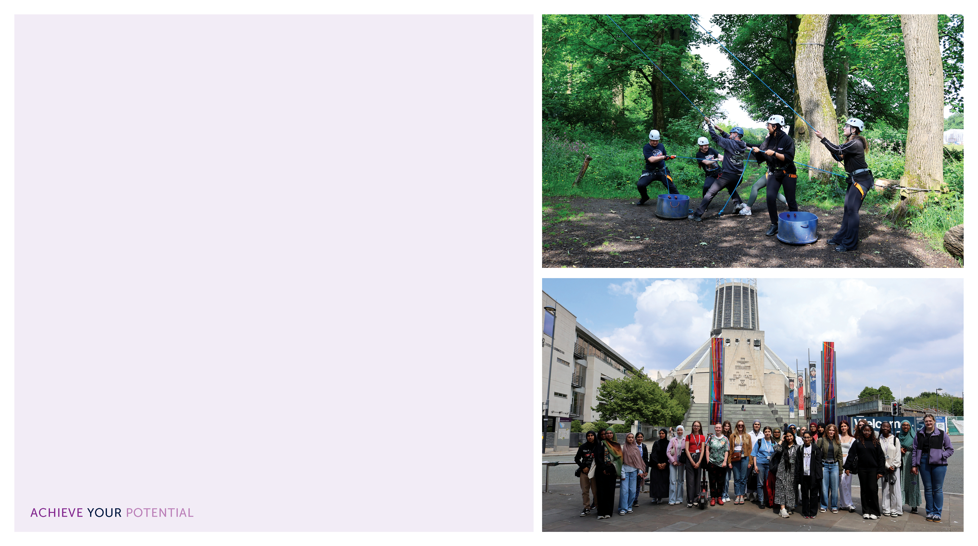
STUDENT LEADERSHIP
PROGRAMME
DEVELOPING FUTURE LEADERS AT THE SIXTH FORM BOLTON
Unique opportunity to grow as confident, capable leaders
Two strands: Women into Leadership and
The Momentum Programme
Builds skills for life beyond The Sixth Form
Key Skills Developed:
Confidence
Public Speaking
Networking
Communication
Organisation
Wellbeing
Students take part in inspiring talks, workshops and trips to prepare for ambitious futures.

Slide 16

HONOURS PROGRAMME
A bespoke aspirational programme for academically gifted students.
Support for specialist university applications, including Oxbridge, Russell Group universities and medical pathways
The study of the Extended Project Qualification (EPQ)
Honours tutorial and skills development programme
Specialist Academies in Science and Law
Participation in prestigious University Access Programmes
Summer Schools and residentials
Cultural trips and visits

Slide 17
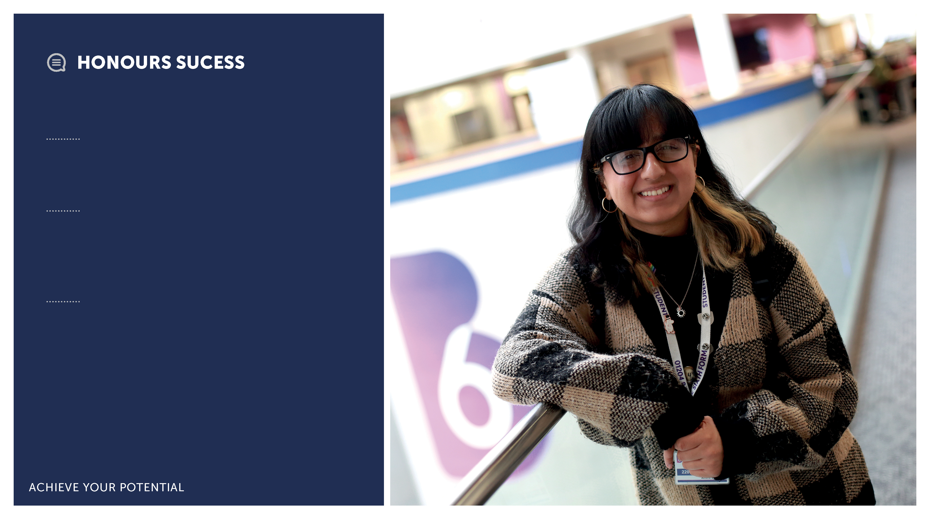
Anisha Mohammed
Former school:
Harper Green School
Destination:
University of Oxford to study Philosophy, Politics and Economics
Grades Achieved:
A Level History (A*)
A Level Mathematics (A) A Level Politics (A*)
Extended Project Qualification (A*)

Slide 18
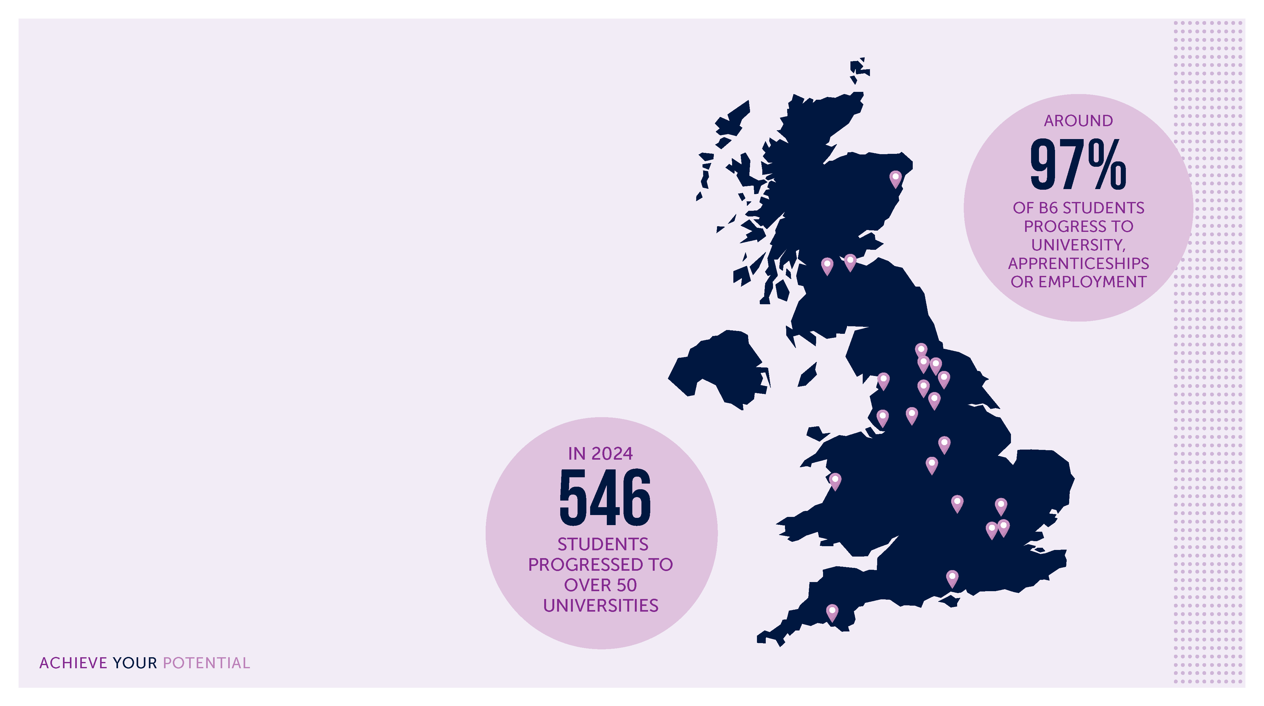
YOUR NEXT STEPS
University of Manchester
University of Liverpool
Lancaster University
University of York
University of Leeds
University of Sheffield
University of Nottingham
University of Edinburgh
University College of London
University of Cambridge
Durham University
Imperial College London
Newcastle University
Oxford University
University of Southampton
University of Warwick
Aberystwyth University
University of Strathclyde
Hull York Medical School
Plymouth University
University of Aberdeen

Slide 19
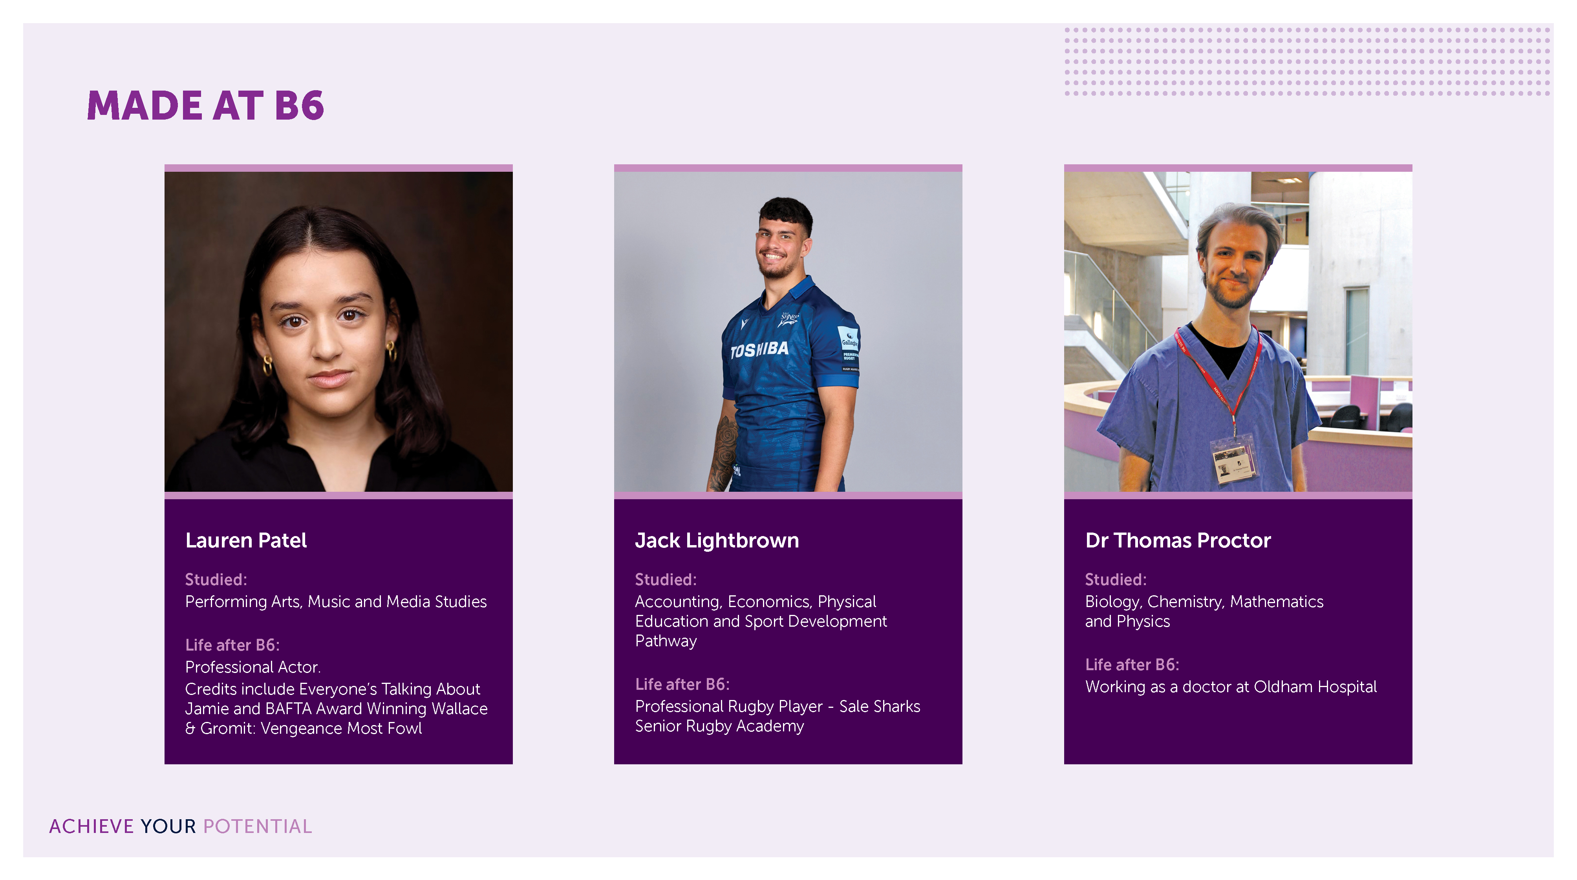

Slide 20

TRAVEL TO
THE SIXTH FORM
Greater Manchester resident students aged 16-18 could be eligible for free bus travel using OUR PASS.
If you use other types of public transport or live outside of Greater Manchester, funds may be available to assist you with this.

Slide 21
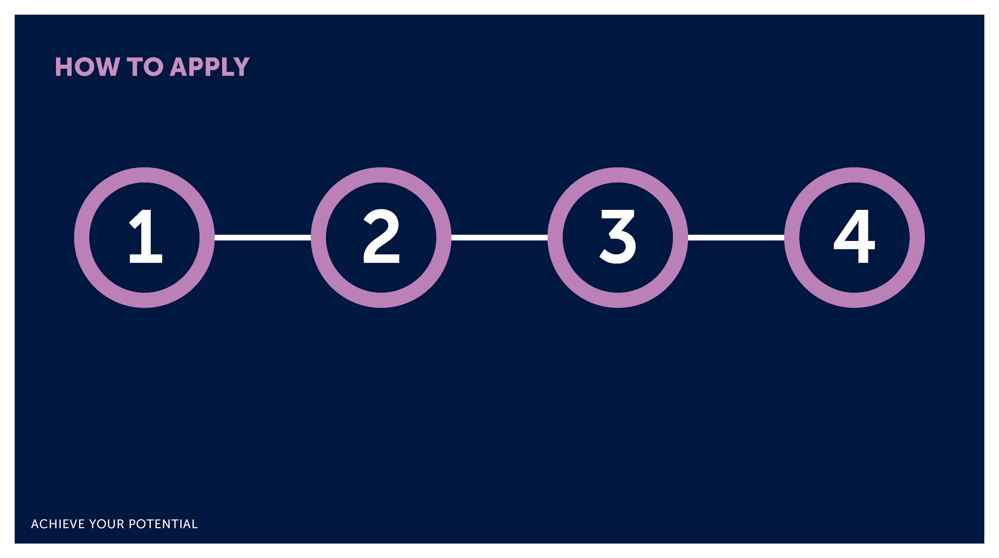
Apply online from
3rd October 2025
via our website:
www.bolton-sfc.co.uk
Don’t miss
the deadline
Friday 30th
January 2026
Interviews are
held November
to March
Enrolment is from Thursday 20th August 2026.
You must attend your enrolment appointment in order to secure
your place.

Slide 22
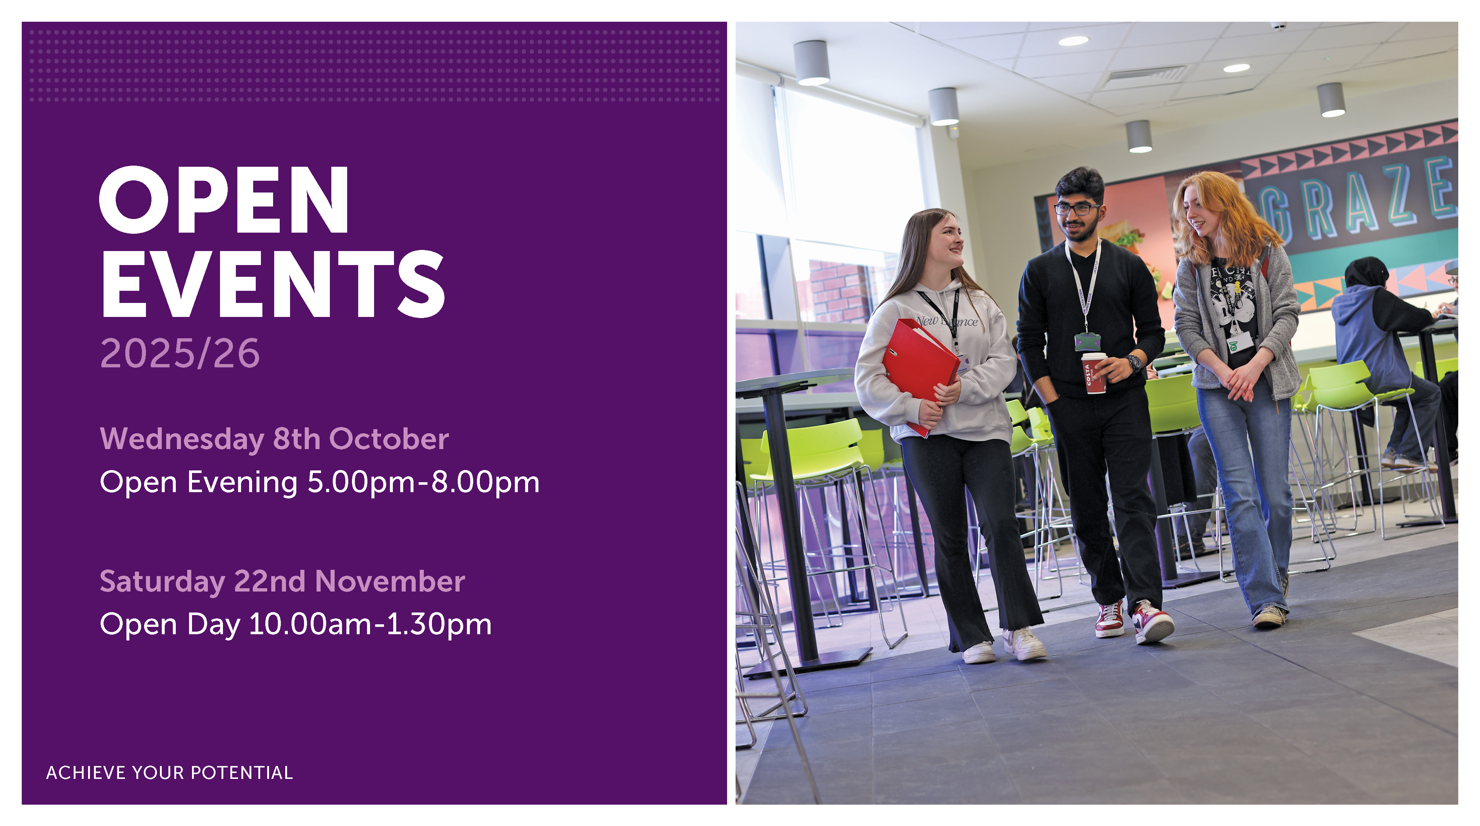

Slide 23
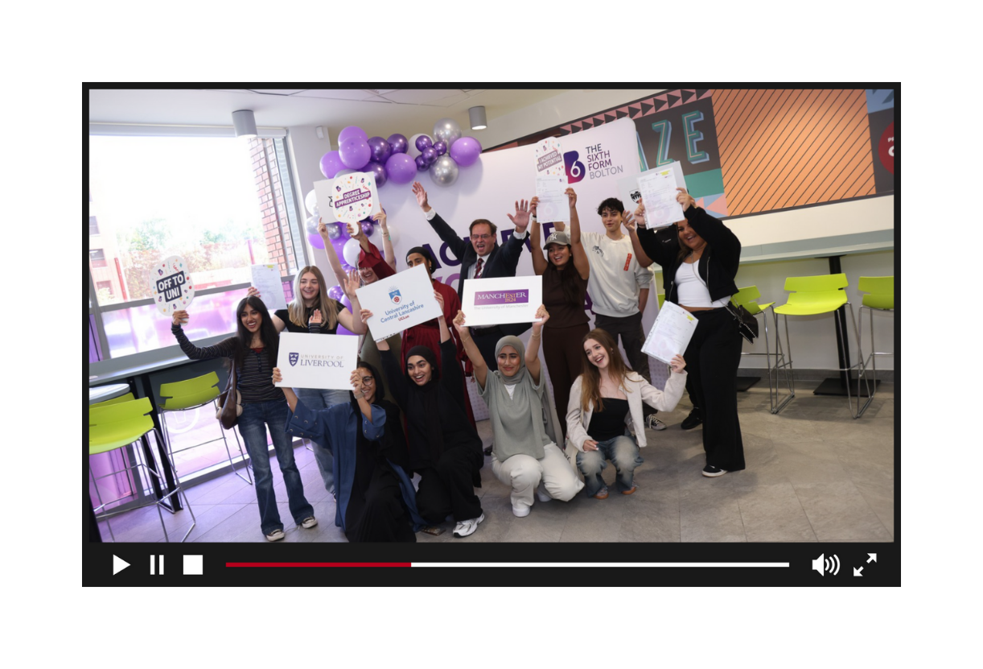

RESULTS DAY PROMO FILM
ACHIEVE YOUR POTENTIAL

